Slide 1
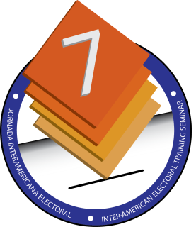
Electoral Accessibility: Tools and mechanisms to facilitate voting for people with disabilities
Sherri-Gaye Davis Field Operations (Jamaica) September 22, 2014, Mexico City

Slide 2
Introduction
Of 2.72 million Jamaicans, approximately 10% of the population is disabled.
The Disabilities Act was passed in July 2014.
Source: Derrick Kellier – Minister of Labour and Social Security

Slide 3
The Disabilities Act (Act of 2014)
“A person with a disability shall not be denied the opportunity to participate in activities or work that relate to political office including:
the opportunity to vote using procedures, facilities and materials that are appropriate, accessible, easy to use and understand.

Slide 4
Disabilities Act (Act of 2014) cont’d
the opportunity to be elected to political office and perform public functions at all levels of government.
involvement in the activities and administration of political parties.”

Slide 5
The Electoral Process (Enumeration)
Voting is preceded by enumeration.
Buildings used as registration centres are mainly privately owned and are usually without proper infrastructure (to facilitate the disabled).
Disabled electors are assisted by conducting registration at the applicant’s home or at ground floors of registration centres, where applicable.

Slide 6
The Electoral Process (Enumeration)
cont’d
Home delivery of Identification cards is facilitated for electors who are physically incapacitated and/or bedridden (at the request of the elector).
Ground floor shops/locations are selected for constituency offices and polling stations, where possible.

Slide 7
The Electoral Process (Voting)
The Electoral Commission of Jamaica (ECJ) does not own the buildings used for voting.
Publicly owned buildings are used, which, in some cases, lack proper infrastructure to accommodate disabled individuals.
Tents are sometimes used as polling stations where multi-floored buildings and/or insufficient space is available to house a polling station.

Slide 8
Assisted Voting
There exists two (2) types/methods of voting
Manual
Electronic (EBVIS)
Assistance is provided for individuals with varying types of disabilities when casting their votes:
Visually impaired
Physically incapacitated

Slide 9
Special Considerations
The Electoral Office of Jamaica (EOJ) has modified its Head Office to ensure accessibility.
The building code in Jamaica is being amended for schools and other public buildings to be constructed to accommodate the disabled.
Elderly persons, heavily pregnant women and the disabled are allowed to go to the front of the line to vote.

